Slide 1
BIG MART SALES ANALYSIS

Slide 2
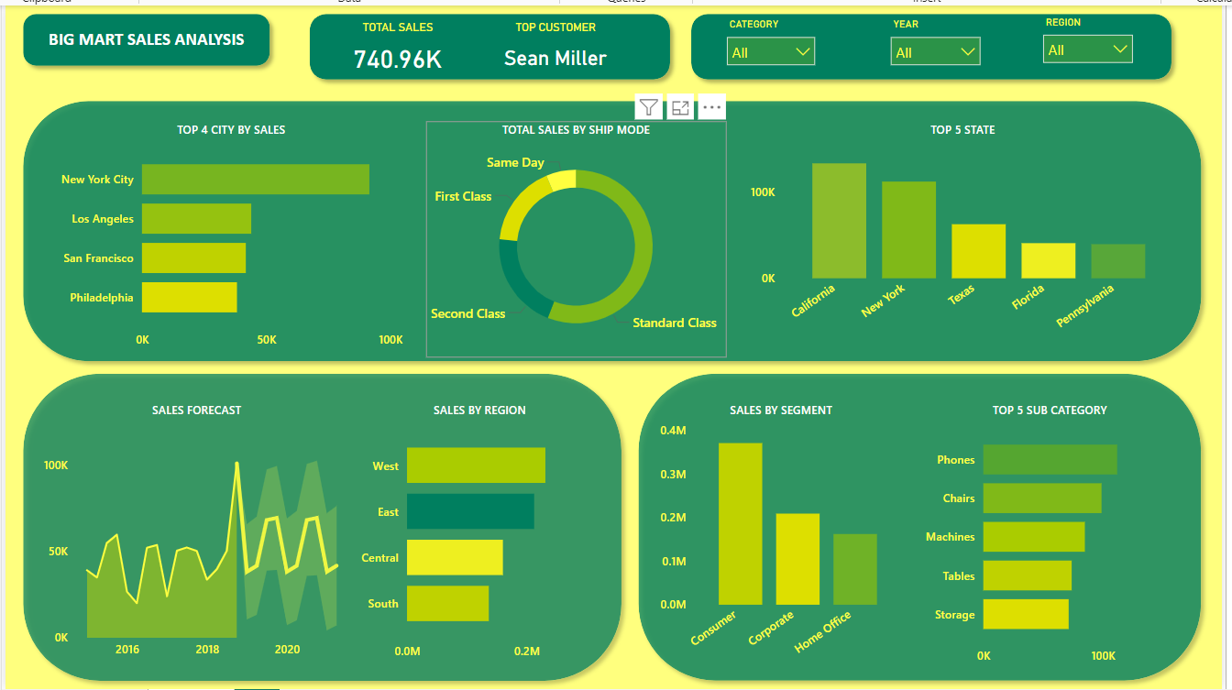

Slide 3
OBSERVATION
Total Sales Overview :
Total Sales ( 740.96k) : This figure represents the overall sales performance across all categories ,regions and years . This magnitude of this number suggest a broad customer base and diversified sales channel .
Top Customer (Sean Miller) : Sean Miller emerges as the top customer indicating either a high volume of purchases or frequent transactions . It would be beneficial to analyze this customers purchase history to identify what drives their loyalty or purchasing behavior .
2. Top City By Sales :
New York City : The sales in New York City exceeds 100k , making it the most lucrative market . Considering the population density and economic activity in New York , it should be strategic to continue focusing marketing efforts here . Expanding the product range or enhancing delivery options could further capitalize on this market .
Los Angeles : The second largest market LA ,given its size ,there may still be untapped potential . Assessing customer demographics and their preferences could uncover opportunities for increased market penetration .

Slide 4
San Francisco , Philadelphia : Both cities are promising sales figures but lag behind New York and LA . These cities could benefit from targeted promotions ,especially in subcategories that perform well in these regions .
The concentration of sales in these four cities suggests that urban markets are a significant driver of revenue. Expanding services or creating exclusive offers for customers in these cities could further strengthen sales .
3. Sales By Shipping Mode :
Standard Class : This is the most dominant class of shipping . This may be due to the cost effectiveness for customers .
However , given its importance , ensuring that the standard class service is crucial and fast is crucial in maintaining the customer satisfaction .
First Class : This option , though less utilized ,indicates a segment of customers willing to pay more for faster shipping .Targeting these customers with premium offers or expedited services could enhance their shopping experience .
Second class : Though like the first class but this class could be bolstered by improving its cost value proposition .
Same day shipping : This could indicate that customers either find the costs too high or the need for urgent deliveries is rare . However , promoting the benefits of Same Day shipping for last minute shoppers or urgent needs could increase its uptake .

Slide 5
4. Top States By Sales :
California : Leads significantly in state wise sales ,driven by the strong performance in cities like San Francisco and LA . Given California’s economic strength , further tailoring marketing campaigns to suit local preferences and leveraging statewide events could be beneficial .
New York : Following California , New York’s sales are robust . The majority of sales likely come from New York city , but exploring upstate regions could open new opportunities .
Texas : Texas shows potential as an emerging market. With large urban centers like Houston and Dallas, regional campaigns that focus on local culture and preferences could further boost sales.
Florida : A steady performer, but with room for growth. Florida’s diverse population and economic activities suggest potential in niche markets or seasonal promotions.
Pennsylvania : Rounding out the top five, Pennsylvania’s sales suggest a stable but underdeveloped market. Identifying key cities or segments within the state for targeted campaigns could enhance performance.

Slide 6
5. Sales forecast :
Sales peak in 2018 : The spike around 2018 could be due to significant event, product launch, or promotional campaign. Analyzing what drove this peak could provide insights for replicating similar success in the future.
Volatility post 2018 : The sales figures show fluctuations, possibly indicating market instability or seasonal variations. Predictive analytics could be employed to smoothen this volatility by anticipating low seasons and launching preemptive promotions.
Sales drop post 2020 : In the line chart under "Sales Forecast," there’s a visible dip in sales post-2020. This suggests that the company experienced a decline in sales during this period. The line chart should be closely examined to identify the exact periods (months/quarters) when the decline started, reached its lowest point, and began recovering . External factors such as covid during 2020 might have been the reason for the downfall of sals during this period . Specific industries were hit harder than others (e.g., retail, travel), which could have influenced sales for products or categories more reliant on those industries . The pandemic led to delays in manufacturing and shipping, causing stockouts and delayed deliveries, which could have impacted sales . The dashboard shows sales by region (West, East, Central, South). You could drill down into this data to see which regions experienced the most significant sales declines. This can help determine if the dip was widespread or isolated to specific regions.
The "Sales by Segment" visualization breaks down sales by Consumer, Corporate, and Home Office segments. Understanding which segment experienced the largest decline could provide insights into customer behavior post
2020 .

Slide 7
6. Sales By Region :
West Region : Driven by California, the West region is the top-performing area. This region likely benefits from strong urban centers, a tech-savvy population, and higher disposable incomes. Continuously innovating and staying ahead of competitors in this market is key.
East Region : The East follows closely behind, likely driven by New York. Expanding into other Eastern cities like Boston or Washington, D.C., might help close the gap with the West.
Central Region :The Central region shows moderate sales. Given the geographic spread, focusing on regional hubs like Chicago or Detroit with specialized campaigns could enhance performance.
South Region : The South lags, which may be due to less urbanization or different consumer behavior. Conducting market research to understand customer preferences in the South and adapting offerings accordingly could drive growth.
7. Sales By Segment :
Consumer Segment : By far the largest segment, suggesting that individual consumers make up the bulk of sales. Ensuring a positive shopping experience, including ease of use on platforms and customer service, will be crucial for retaining and growing this base.

Slide 8
Corporate Segment : A significant portion of sales comes from businesses. Offering business-centric products or bulk purchasing options could further solidify relationships with corporate clients.
Home Office Segment : The smallest but still noteworthy, this segment may have seen growth during remote work periods. Continuing to cater to home office needs (e.g., ergonomic furniture, tech accessories) could maintain this segment’s relevance.
8. Top 5 Sub categories By Sales :
Phones : Leading the sub-categories, Phones are likely a key product driving sales. Ensuring availability and offering the latest models could keep this sub-category at the top.
Chairs and Machines : Both categories are significant contributors, possibly reflecting office furniture and tech equipment demand. Promoting ergonomic designs and high-efficiency machines could boost sales.
Tables and Storage : These categories, while performing well, could see increased sales with targeted promotions, bundling with related products, or highlighting versatility and space-saving features.

Slide 9
STRATEGIC RECOMMENDATIONS :
Geographical Expansion : Given the concentration of sales in a few states and cities, exploring secondary markets within those states or expanding to nearby states could uncover new opportunities.
Shipping Optimization : Since Standard Class dominates, optimizing this service for cost and reliability will be key. Encouraging the use of Same Day or First Class through targeted promotions could diversify shipping choices and increase revenue from these modes .
Product Focus : Strengthening the product portfolio in the most popular sub-categories (Phones, Chairs, Machines) while exploring customer needs in lesser-performing categories could create balanced growth .
Customer Segmentation : With a large consumer segment and a growing corporate base, segmenting marketing efforts to cater specifically to each group’s needs (e.g., personalized offers, bulk discounts) could enhance customer loyalty and sales.

Slide 10
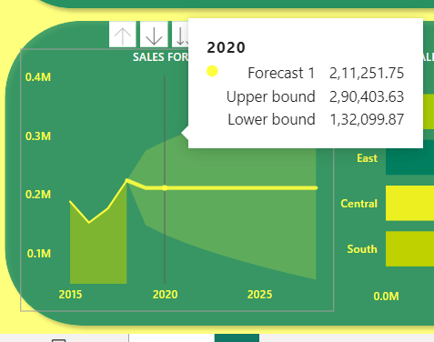
SALES FORECAST ANALYSIS
A) 2015 SALES LEVEL :
The chart shows sales at approx (0.2) million in 2015 . This year likely represents a period of relatively stable or moderate performance .
Trend Analysis (2015-2020):
Decline : Post-2015, there is a visible decline in sales, with the sales value decreasing each year until 2020. By 2020, sales have dropped to below 0.1 million.
Possible causes :
Market Saturation : The product or service may have reached a saturation point, leading to decreased demand.
Increased Competition : New competitors entering the market or existing competitors improving their offerings might have eroded the company’s market share.

Slide 11
Economic factors : Broader economic downturns or industry specific challenges could have impacted consumer spending .
Product Lifecycle : The decline could also indicate that the product is in the maturity or decline phase of its lifecycle, necessitating innovation or diversification.
B) Forecasting Model Interpretation ( 2020-2025) :
2020 Forecast :
Point Forecast : The model predicts sales of 2,11,251.75 for 2020. This represents a significant increase from the historical sales figures, which could suggest that the model anticipates a reversal of the declining trend.
Prediction Interval :
Upper Bound : 2,90,403.63 units/currency. This figure represents the best-case scenario where favorable conditions prevail .
Lower Bound : 1,32,099.87 units/currency. This is the worst-case scenario, possibly under less favorable market conditions.
Interpretation : The wide range between the upper and lower bounds (approximately 1,58,303.76 units/currency) indicates a high degree of uncertainty in the model. This could be due to volatility in the market or challenges in accurately predicting future sales based on the historical data .

Slide 12
Post 2020 Forecast :
Flat Trend : The forecast line from 2020 onwards is relatively flat, suggesting little to no expected growth. This may indicate that while the decline has been arrested, the model doesn’t anticipate strong growth drivers in the near future.
Expanding Prediction Interval :
The shaded area between the upper and lower bounds increases as the timeline progresses, which is typical in forecasting models due to the compounding uncertainty over time. This suggests that while the model provides a baseline expectation, external factors could significantly influence actual outcomes.
C. In-depth Implications :
Stabilization of Sales : The model suggests that 2020 might be a turning point where sales stabilize . This could indicate the company has taken corrective actions , such as revising its marketing strategy , introducing new products or improving operational strategy .
Lack of Growth Indicators : The flat forecast suggests the absence of significant growth drivers. This could mean :
Market saturation continues : Without innovation or expansion into new markets, the company may struggle to grow.
Price sensitivity : The market might be highly price-sensitive, limiting the company’s ability to raise prices or introduce premium products.

Slide 13
Customer Retention vs Acquisition : The company might need to focus more on customer retention strategies rather than purely acquiring new customers.
Strategic Recommendations :
Product Diversification : To counter the flat growth forecast , the company should explore diversifying its product line . This could involve introducing complementary products or tapping into related market .
Market Expansion : Consider geographic expansion into untapped markets, particularly those with high growth potential. This could help mitigate the limitations observed in the current forecast.
Data driven decision making : Given the wide prediction intervals, the company should implement more robust data collection and analysis techniques, potentially incorporating real-time sales data, customer feedback, and external economic indicators.
Focus on Customer Insights : Understanding customer behavior and preferences through more granular data analysis could reveal hidden opportunities for growth .
D. Potential Risk & Considerations :
Model Assumptions : The forecasting model appears to assume a certain level of market stability, which might not hold true if there are sudden economic shifts, new regulations, or technological disruptions .

Slide 14
External factors : Factors such as changing consumer preferences , global supply chain disruptions , or economic recessions could drastically alter the forecasted outcomes .
Innovation needs : Without innovation or significant changes in strategy, the company may only maintain its current position without achieving significant growth.

Slide 15
BIG MART SALES ANALYSIS
The End !!!

